Slide 1

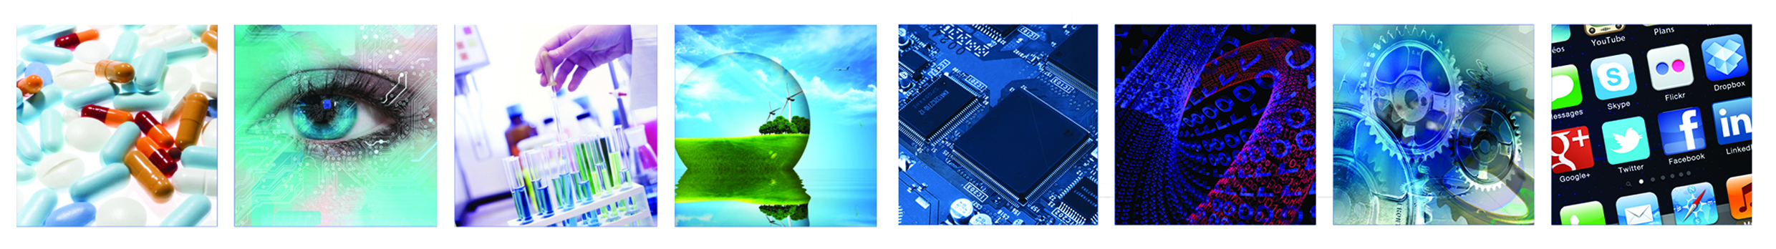
2nd IATI MNC Weekathon
Demo Day

Slide 2
Blind-Phone Project

Slide 3
Blind Phone - BackGround

Slide 4
The Blind Phone Use Case
Put movie here

Slide 5
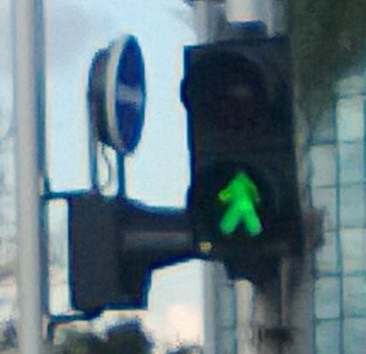
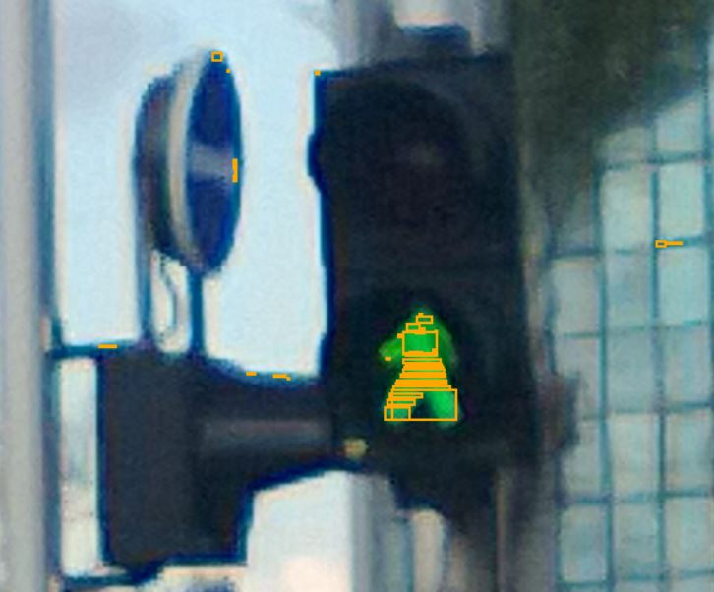
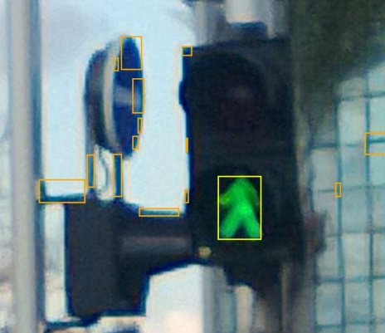
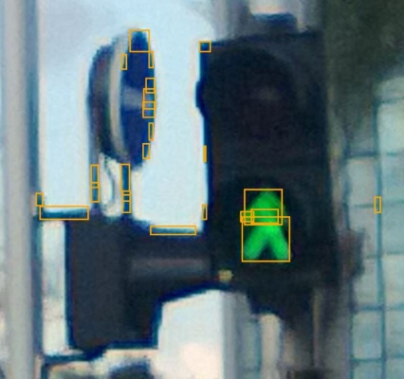
Image Processing Algorithm – Work Flow
Initial Traffic light Image
Find Red or Green Color Ranges
Group Adjacent Objects
Dilate the Objects

Slide 6







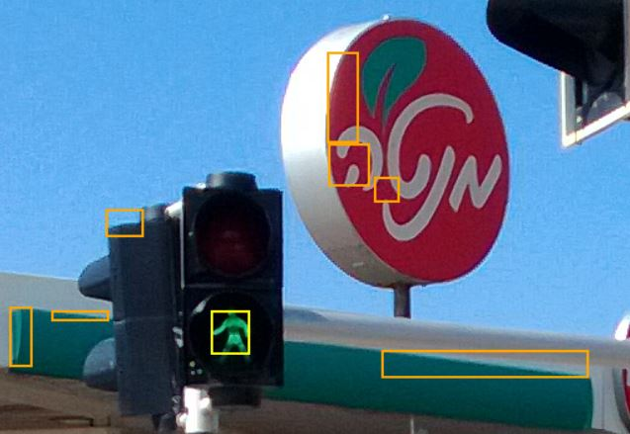
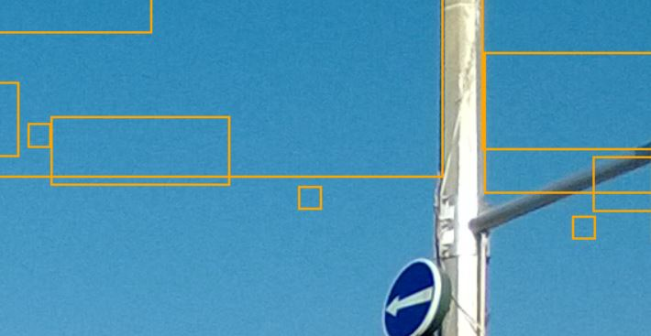
Image Processing Algorithm – Color Ranges
RGB Color Range varies, mainly due to Day Light and Shading
Requires to expand Red and Green Color Ranges to search in the image
Leads to finding other objects that fall into the searched range.
Sometimes, even sky.

